Slide 1
Lecture
HTML Images

Slide 2
Use for Images
Photos and Graphics
Buttons for Navigation
Bullets for Lists
Backgrounds
Symbols and Icons
Logos

Slide 3
Adding an Image
Local File: Best Choice
<img src=“filename.gif”>
Don’t make external links!
<img src=“http://www.whatever.com/filename.gif”>
Not dependable – remote file and location may change)
Unable to manipulate/crop remote image in photo editor

Slide 4
Image Troubleshooting
<img=“logo.gif”>
<img src=“logo”>
<img src=logo.jpg>
<img src=‘logo.gif’>

Slide 5
Image as Link
Surround the image tag with an anchor:
<a href=“index.html”><img src=“house.jpg”></a>
(Click on house instead of text)

Slide 6
Image Attributes & Values
Height
  <img src=“logo.gif” height=“150”>
Width
  <img src=“logo.gif” width=“150”>
Alt
  <img src=“logo.gif” alt=“Gigi’s”>
Border
  <img src=“logo.gif” border=“0”>
Use all together:
  <img src=“logo.gif” height=“150” width =“150” alt=“Gigi” border=“0”>

Slide 7
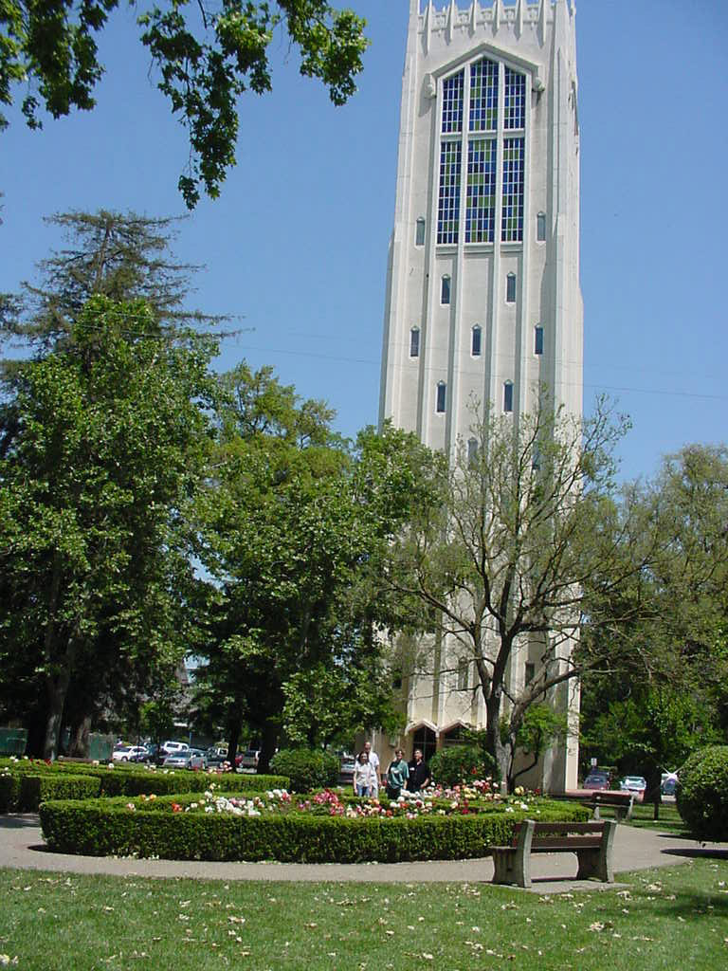
Resizing Photos
Some photos (especially from digital cameras) are too big!
They can take a long time to download or distort the layout of your website

Slide 8
Resizing Photos
Two Ways:
  HTML
  Image Editing Program

Slide 9
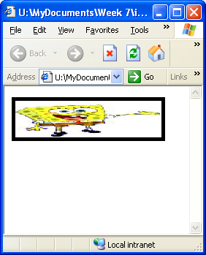
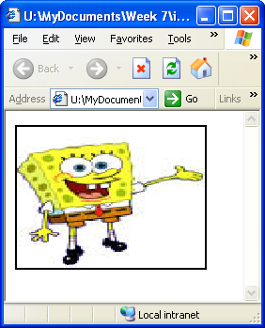
Resizing Photos in HTML
IMG Tag Review:
  <img src=“filename.jpg”
  height=“150”
  width=“200”
  border=“2”>
Risk distorting photo
and longer load times
“50”
“200”
“5”

Slide 10
Resizing Photo Files
Open photo in Paint
Image | Stretch/Skew (Ctrl-W)
Enter new % size (like 30%), hit OK
File | Save As
  Don’t overwrite original file
  Give it a meaningful name
Or Resize in Paint.Net

Slide 11

Resizing Photo Files
Resized in Paint
231 x 308
257 KB
No Change
768 x 1024
1.2 MB
Resized in HTML
231 x 308
1.2 MB

Slide 12
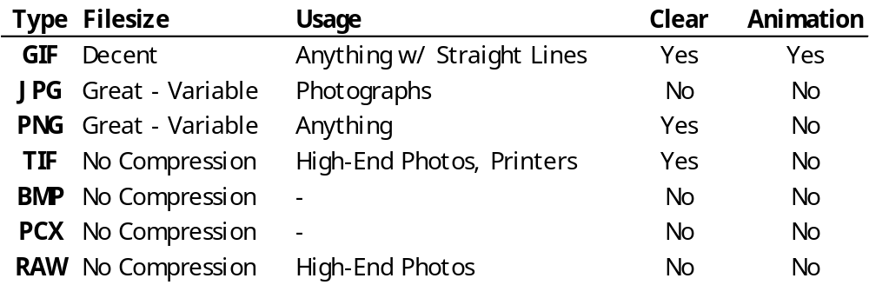
Image File Types
*
* Not on all browsers (IE6).

Slide 13

Image Position on Page
Using the align attribute, you can choose to put your image and the left or right edge and have the text wrap around the image:
<img src=“cake.jpg” align=“left”>
To create additional blank
space around the image
add the attribute
hspace=“pixels” or
vpace=“pixels” where pixels is
the number of pixels you
choose:
<img src=“cake.jpg” align=“left” hspace=“20”>
Notes:
http://www.ironspider.ca/graphics/alignment.htm

Slide 14

HTML Symbols
Symbols can be represented as HTML code
  eg: &diams;
♥ ♠ ♣ ♦ Entities for Symbols and Greek Letters
Check out the Title tag!

Slide 15


Notes on Transparent gifs
Link to reading

Slide 16
Image as Background
Images can be set as the background for the entire page, or just a single element like a <h1> or <p> tag.
Borders and alignments of images will also be covered!
We’ll learn how to do this in the next lesson about CSS.

